Slide 1
Lists – Queues – Stacks ADT
atjahyanto@gmail.com

Slide 2
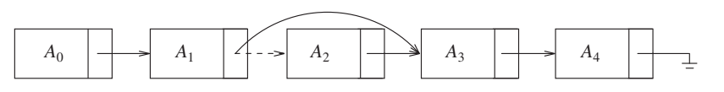
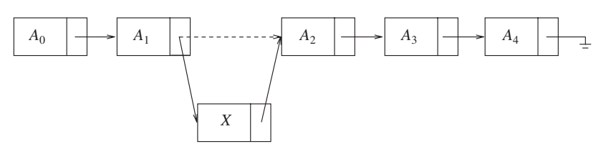
Linked Lists
Linked List
Delete
Insert

Slide 3
Java Collections Library
class Node {
int data;
Node next;
public Node(int data) {
this.data = data;
this.next = null;
}
}
class LinkedList {
Node head;
public LinkedList() {
this.head = null;
}
public void insert(int data) {
Node newNode = new Node(data);
if (head == null) {
head = newNode;
} else {
Node current = head;
while (current.next != null) {
current = current.next;
}
current.next = newNode;
}
}
public void display() {
Node current = head;
while (current != null) {
System.out.print(current.data + " -> ");
current = current.next;
}
System.out.println("null");
}
}
public class LinkedListExample {
public static void main(String[] args) {
LinkedList linkedList = new LinkedList();
linkedList.insert(10);
linkedList.insert(20);
linkedList.insert(30);
linkedList.display();
}
}
import java.util.LinkedList;
public class LinkedListExample {
public static void main(String[] args) {
LinkedList<Integer> linkedList = new LinkedList<>();
linkedList.add(10);
linkedList.add(20);
linkedList.add(30);
System.out.println("Linked List: " + linkedList);
}
}
Library
From the scratch

Slide 4
Linked List Iterator
import java.util.LinkedList;
import java.util.Iterator;
public class LinkedListIterationExample {
public static void main(String[] args) {
LinkedList<String> linkedList = new LinkedList<>();
linkedList.add("Apple");
linkedList.add("Banana");
linkedList.add("Orange");
// Using for-each loop
System.out.println("Using for-each loop:");
for (String fruit : linkedList) {
System.out.println(fruit);
}
// Using Iterator
System.out.println("\nUsing Iterator:");
Iterator<String> iterator = linkedList.iterator();
while (iterator.hasNext()) {
System.out.println(iterator.next());
}
}
}

Slide 5
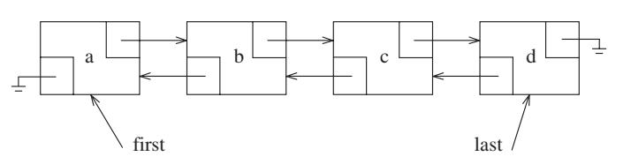
Doubly Linked List

Slide 6
Doubly Linked List
import java.util.LinkedList;
import java.util.ListIterator;
public class DoublyLinkedListExample {
public static void main(String[] args) {
LinkedList<Integer> linkedList = new LinkedList<>();
linkedList.add(10);
linkedList.add(20);
linkedList.add(30);
System.out.println("Forward traversal:");
ListIterator<Integer> forwardIterator = linkedList.listIterator();
while (forwardIterator.hasNext()) {
System.out.print(forwardIterator.next() + " <-> ");
}
System.out.println("null");
System.out.println("\nBackward traversal:");
ListIterator<Integer> backwardIterator = linkedList.listIterator(linkedList.size());
while (backwardIterator.hasPrevious()) {
System.out.print(backwardIterator.previous() + " <-> ");
}
System.out.println("null");
}
}

Slide 8

List of Students
import java.util.LinkedList;
class Student {
String name;
int rollNumber;
double GPA;
public Student(String name, int rollNumber, double GPA) {
this.name = name;
this.rollNumber = rollNumber;
this.GPA = GPA;
}
@Override
public String toString() {
return "Name: " + name + ", Roll Number: " + rollNumber + ", GPA: " + GPA;
}
}
public class StudentLinkedListExample {
public static void main(String[] args) {
LinkedList<Student> studentList = new LinkedList<>();
Student student1 = new Student("Alice", 101, 3.8);
Student student2 = new Student("Bob", 102, 3.5);
Student student3 = new Student("Charlie", 103, 3.2);
studentList.add(student1);
studentList.add(student2);
studentList.add(student3);
System.out.println("Student Records:");
for (Student student : studentList) {
System.out.println(student);
}
}
}

Slide 9

Queue of Students
import java.util.LinkedList;
import java.util.Queue;
class Student {
String name;
int rollNumber;
double GPA;
public Student(String name, int rollNumber, double GPA) {
this.name = name;
this.rollNumber = rollNumber;
this.GPA = GPA;
}
@Override
public String toString() {
return "Name: " + name + ", Roll Number: " + rollNumber + ", GPA: " + GPA;
}
}
public class StudentQueueExample {
public static void main(String[] args) {
Queue<Student> studentQueue = new LinkedList<>();
Student student1 = new Student("Alice", 101, 3.8);
Student student2 = new Student("Bob", 102, 3.5);
Student student3 = new Student("Charlie", 103, 3.2);
studentQueue.add(student1);
studentQueue.add(student2);
studentQueue.add(student3);
System.out.println("Student Queue:");
while (!studentQueue.isEmpty()) {
System.out.println(studentQueue.poll());
}
}
}

Slide 10
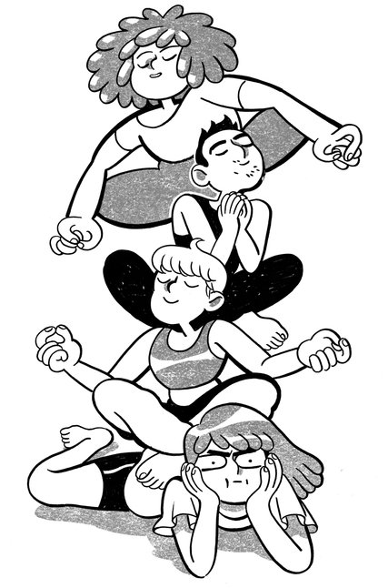
Stack of Students
import java.util.Stack;
class Student {
String name;
int rollNumber;
double GPA;
public Student(String name, int rollNumber, double GPA) {
this.name = name;
this.rollNumber = rollNumber;
this.GPA = GPA;
}
@Override
public String toString() {
return "Name: " + name + ", Roll Number: " + rollNumber + ", GPA: " + GPA;
}
}
public class StudentStackExample {
public static void main(String[] args) {
Stack<Student> studentStack = new Stack<>();
Student student1 = new Student("Alice", 101, 3.8);
Student student2 = new Student("Bob", 102, 3.5);
Student student3 = new Student("Charlie", 103, 3.2);
studentStack.push(student1);
studentStack.push(student2);
studentStack.push(student3);
System.out.println("Student Stack:");
while (!studentStack.isEmpty()) {
System.out.println(studentStack.pop());
}
}
}

